Slide 1

Constructors in C#

Slide 2
Default Constructors
Default constructors are implicitly provided by the compiler if no constructors are defined. They have no parameters and are used to initialize object members to default values. Understanding default constructors is essential for understanding how objects are created in C#.

Slide 3
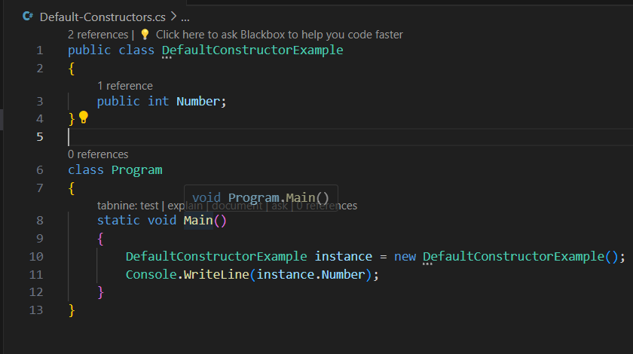
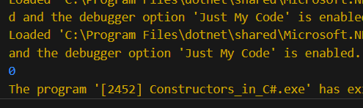

Slide 4
Parameterized Constructors
Parameterized constructors allow for customized initialization of objects by accepting parameters. They enable the setting of specific values during object creation. Mastering parameterized constructors is crucial for creating flexible and customizable objects in C#.

Slide 5
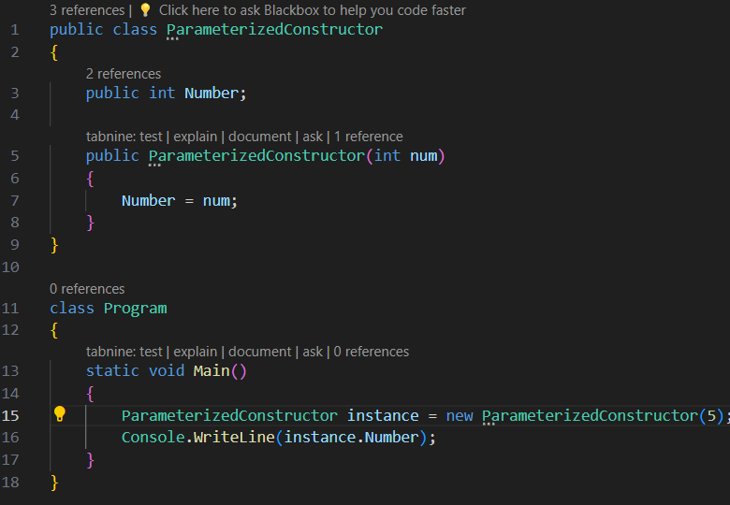
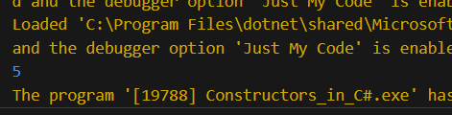

Slide 6
Private Constructors
Private constructors restrict the creation of objects of a class to within the class itself. They are useful for implementing singleton and factory patterns. Understanding private constructors is important for controlling object creation and enforcing design patterns.

Slide 7
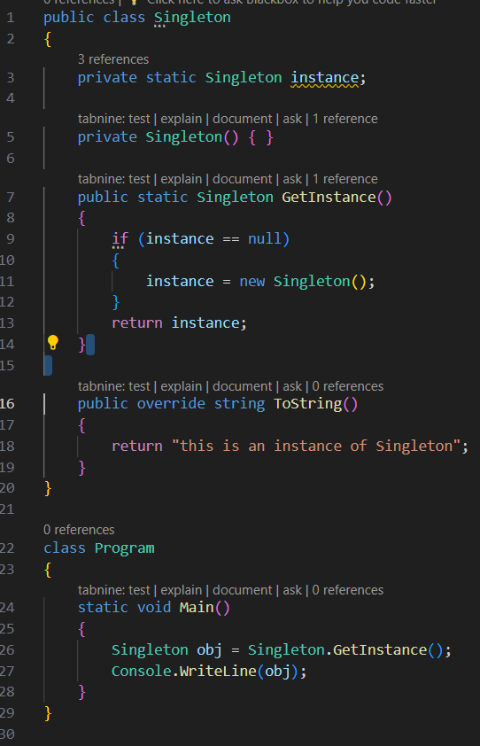
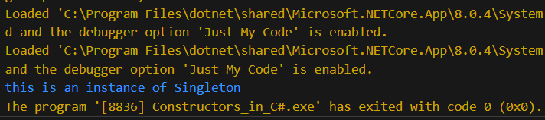

Slide 8
Static Constructors
Static constructors are used to initialize static class members. They are called once, automatically, when the class is first accessed. Static constructors are crucial for initializing static members and performing one-time setup tasks.

Slide 9
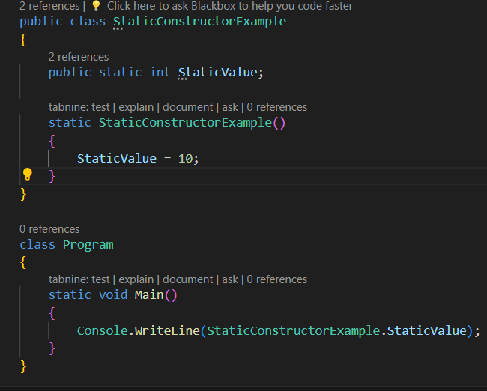
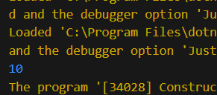

Slide 10
Copy Constructors
A copy constructor is used to create a new object as a copy of an existing object. It ensures that the new object has the same state as the original object and provides a way to create a separate copy without affecting the original object.

Slide 11
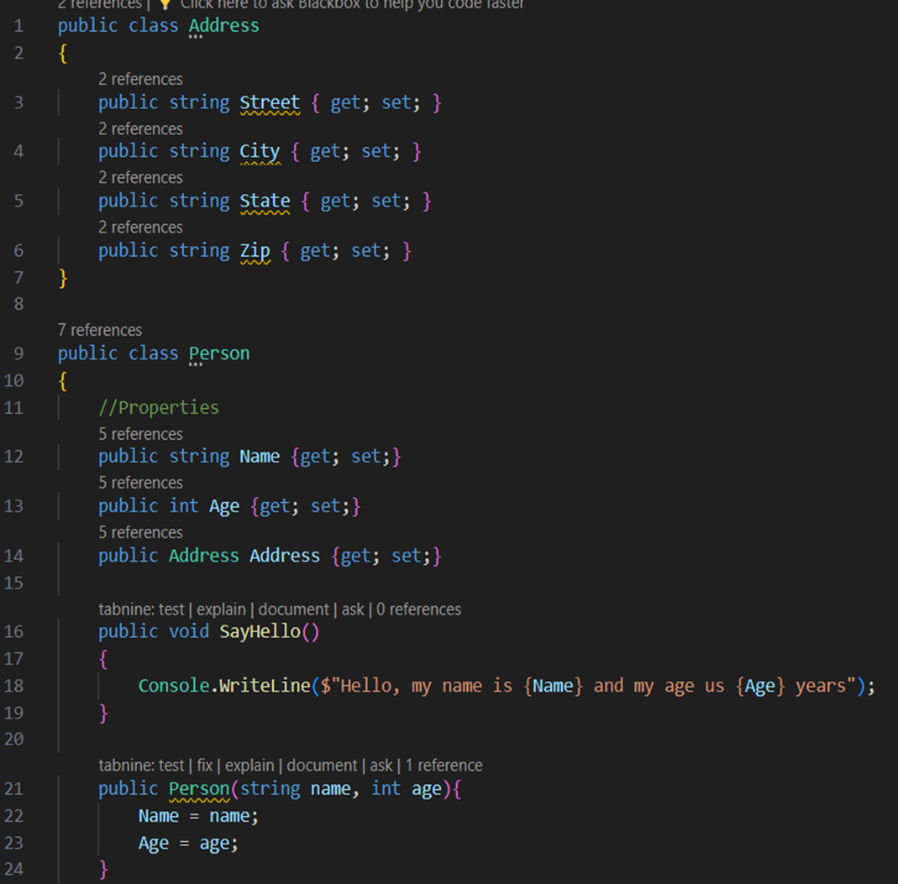
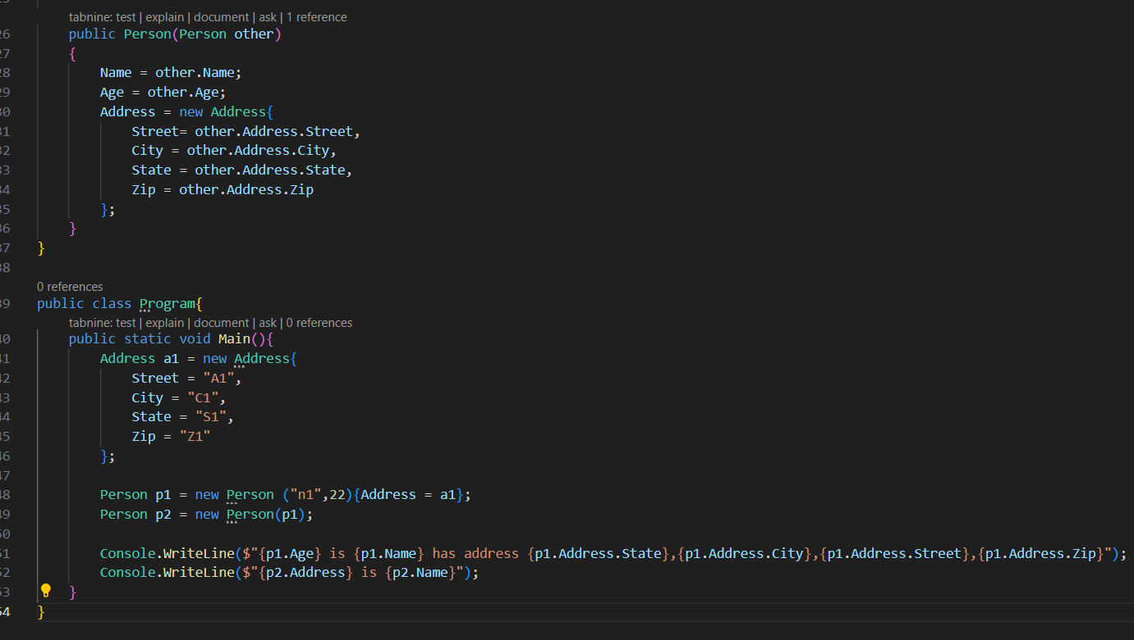

Slide 12
Instance Constructors
Instance constructors are special methods called when an object of a class is created. They can be overloaded and can take parameters to allow different ways of initializing a new object.

Slide 13
